Slide 1
Phase 2 Project
Ayaya Vincent
Rachael Nyawira
Stephen Kamiru
Cindy Minyade

Slide 2
Business Understanding:
Our company noticed that all the other big companies are really involved in original video control. We now want to get into the fun.
The company now wants to create a new movie studio. However, they don’t know anything about movie creation.
With the data provided, we will be able to provide insights on the best way forward for the company to take.

Slide 3
Data: Understanding.
We dealt with different data sources: SQL database and csv files.
Most of this data was stored in a zipped file and we therefore had to unzip them first before trying to understand what we were dealing with.
The SQL database was ‘im.db’ while the CSV file that we worked with was ‘bom.movie_gross.csv’

Slide 4

Data: Analyzing
For us to get proper insights from the data, we needed to analyze it first.
This involved processes such as :
data cleaning,
joining tables,
importing of the CSV file to the database,
grouping and ordering data,
filtering data.
This enabled us get a clear vision of what insights might help the company make data-driven decisions

Slide 5

RECOMMENDATIONS:
From the analysis of the data, here are some of the questions we looked to answer with the corresponding visualizations:

Slide 6
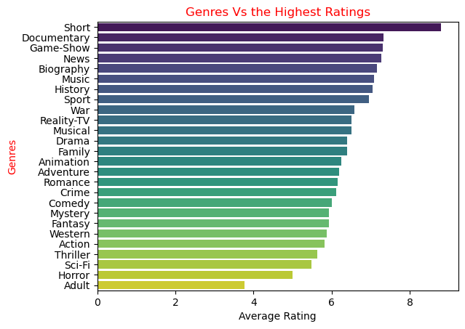
Question one
What genre are currently being watched with the highest rating?
Conclusion: The studio to consider producing movies with genres of 6.5 average and above as follows;
1. Short
2. Documentary
3. Game-Show
4. News
5. Biography
6. Music
7. History
8. Sport
9. War
10. Reality-TV
Conclusion:

Slide 7
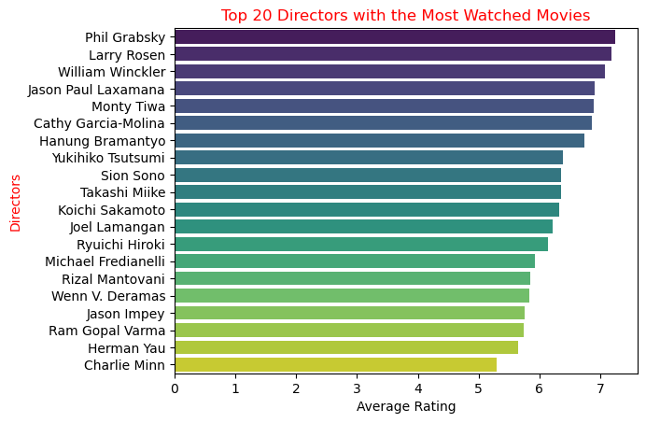
Question Three
Which directors produce the most watched film?
Conclusion: The studio can consider working with these directors during movie production since they have higher ratings.

Slide 8
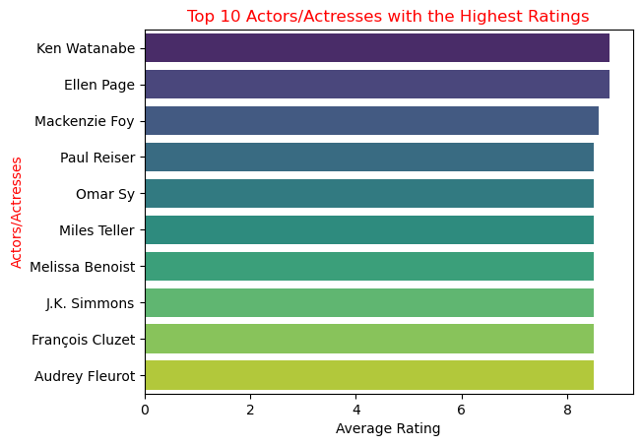
Question Two
Which Actors have been featured in a film with a higher rating?
Conclusion: Since these actors/actresses have been involved in movies with the highest ratings, producers can consider utilising them to produce their movies.

Slide 9
What Next?
Now, the business stakeholders will have a look at these recommendations and make data-driven decisions.
Some of these decisions, based off the visualizations, include:
What movie genres have the highest ratings? From the visuals, short films, documentaries and game-shows ten to have a higher rating.
Which actors have featured in films with high ratings? From the visual, Ken Wantanabe, Ellen Page and Mackenzie Foy are some of the actors who rank highly in this criteria. So, the company can employ them as actors.
Which directors have produced highly rated movies? Well, from the visual, Phil Grabsky, Larry Rosen and William Winckler have directed films that have been rated highly. The company can go for them in their search for directors.

Slide 10
Conclusion
With these visualizations, the company now has the blueprint to move forward with the project.

Slide 11

Thank you
😁👍

